Slide 1
Casting Sim2Real as
Meta-Reinforcement Learning

Slide 2



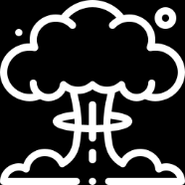
Agenda
Motivation
What‘s new
PEARL
PEARL2
Experiments

Slide 3
Motivation
Sim2Real describes the problem of transferring a policy learned in simulation to the real world
Simulations are great because they are low risk and low cost
Ultimate goal is to train agent in simulation and adapt the policy in real world in a sample efficient way
Investigate meta-reinforcement learning on distribution of simulated tasks for sample efficient adoption in new tasks

Slide 4
Our Environement

Slide 5
What‘s new
Implemented PEARL
Implemented variation of PEARL
Out of distribution experiments
Random wind dynamics
Many experiments

Slide 6
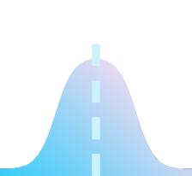






PEARL
Off policy meta reinforcement learning
Based on SAC
Probabalistic context model to condition actor and critic
Minimize KL-Divergence
Encoder buffer
$$μ$$
s, a ,r
Encoder
$$σ$$
z
Train Tasks
Replay buffer
$$μ$$
s, a, r
Actor(s, z)
a
$$σ$$
Critic(a, s, z)

Slide 7




PEARL2
Only use context from current trajectory
Infer posterior distribution during trajectory execution
More realistic approach
One Gaussian per context sample
$$μ$$
s, r, a
Encoder
Product of Gaussians
$$σ$$
Prior Distribution
Trajectory buffer
z
s, a, r
Actor(s, z)

Slide 8
Experiments
Gravity
Domain randomization
Random training parameters
Validation on grid
Out of distribution
Random training parameters
Validation on grid
Wind
Turbulence
Gravity
testing
training
Turbulence
Wind

Slide 9
Experiments
Comparing models
SAC
SAC2
PEARL
PEARL2
Different modes
Inside distribution
Out of distribution
Passing parameters
Not passing parameters
Fixed wind
Random wind
SAC
PEARL
uninformed
SAC
PEARL
SAC2
PEARL2
SAC2
PEARL2
Inside distribution
Out of distribution
SAC
SAC
SAC2
SAC2
informed

Slide 10
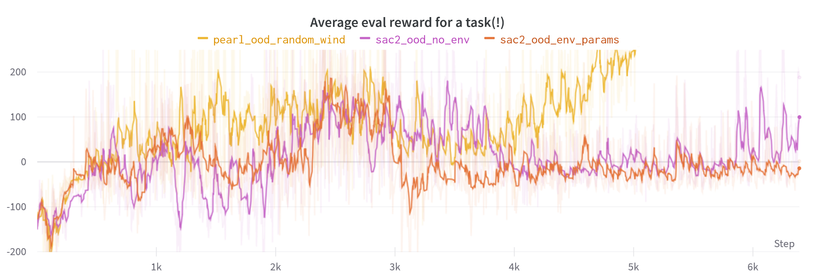
Experiments - OOD
PEARL outperforms SAC & SAC2 in OOD case
PEARL solved all 27 evaluation tasks after 5k steps
(in that set of experiments PEARL has 5 latent dimensions)

Slide 11
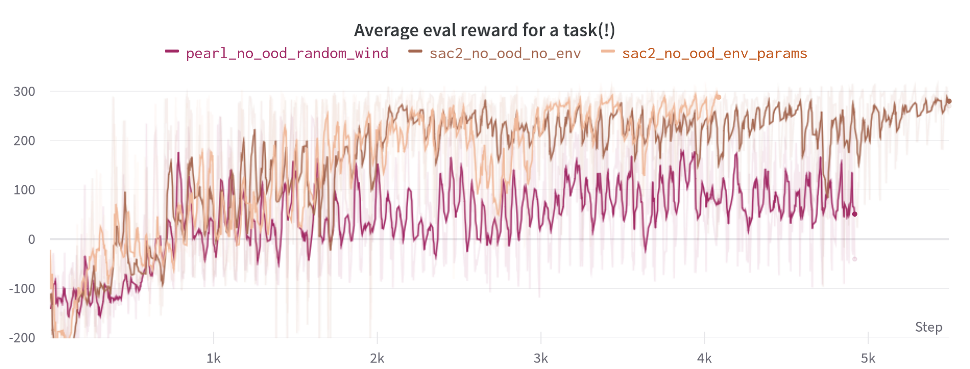
Experiments - ID
SAC & SAC2 outperform for PEARL inside distribution tests
Latent size of 5

Slide 12
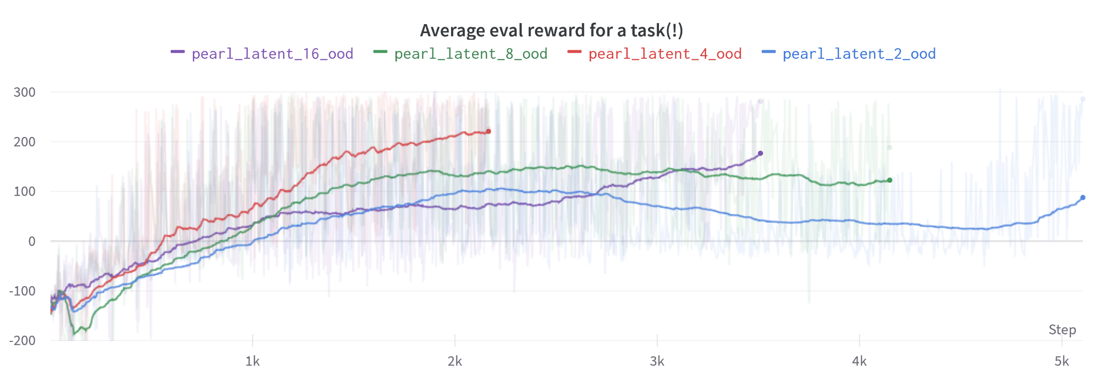
Experiments – PEARL latent size
PEARL performs best for latent size of 4
More than 4 overfits, less than 4 underfits

Slide 13
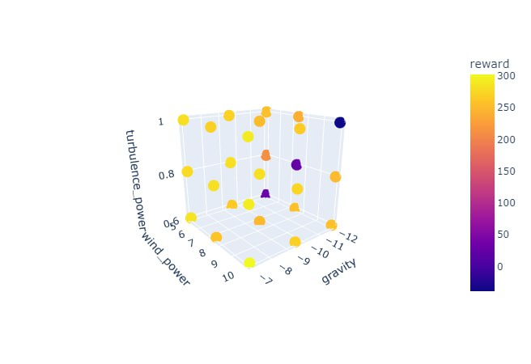
Experiments – Validation Hypercube
PEARL Validation OOD
In OOD validation PEARL performs worst for high gravity setting
Gravity has strongest impact on reward from all three parameters
PEARL was trained on low gravity

Slide 14
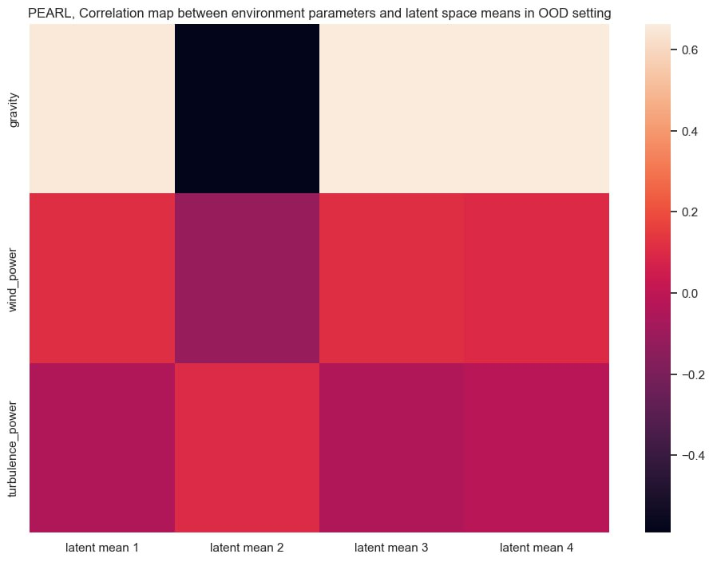
Experiments – Latent Correlation Map
How does PEARL encode environment parameters?
Explored for the best model with 4 latens variables
Correlation map shows:
Latent variable 1 & 3 have same correlations
Latent variable 2 is orthogonal
variable 4 slightly different to 1 & 2

Slide 15
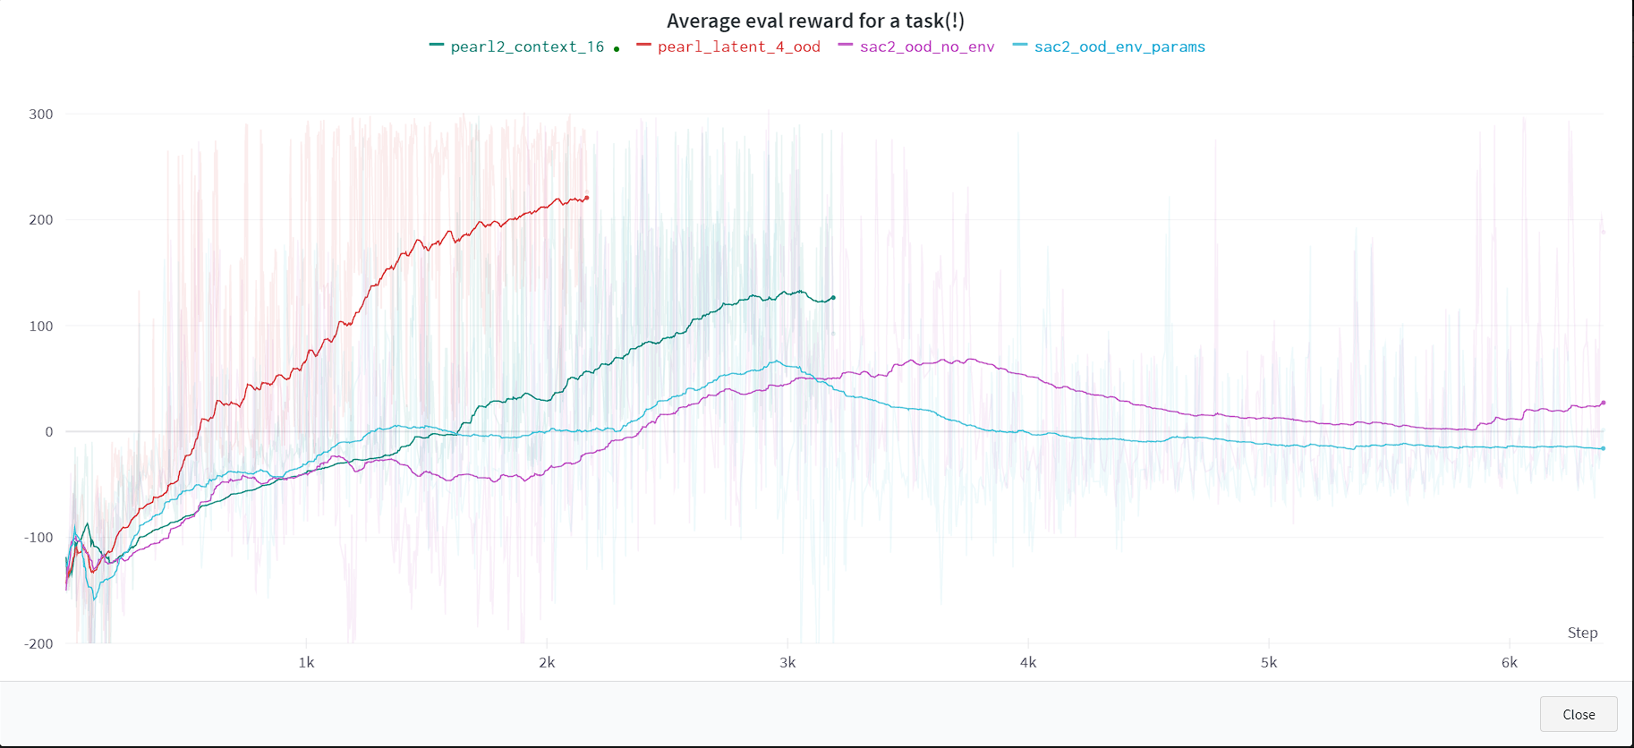
Perfomance of PEARL2
PEARL2 was trained in hurry with small batches, still outperforms SAC

Slide 16
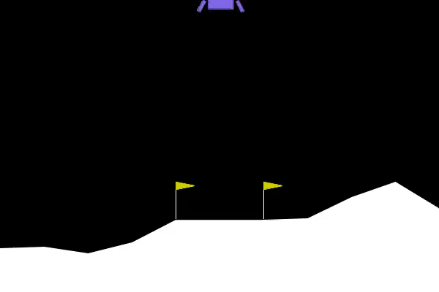
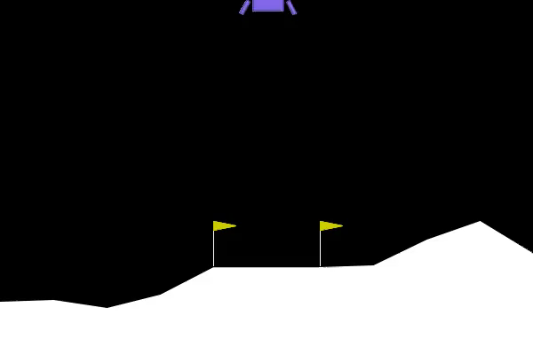
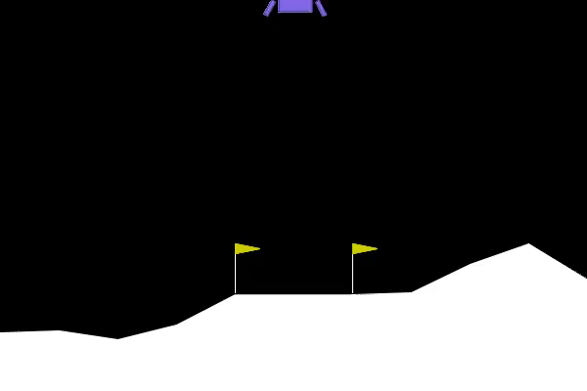
Demonstration – the hardest case
PEARL
SAC2
PEARL2

Slide 17
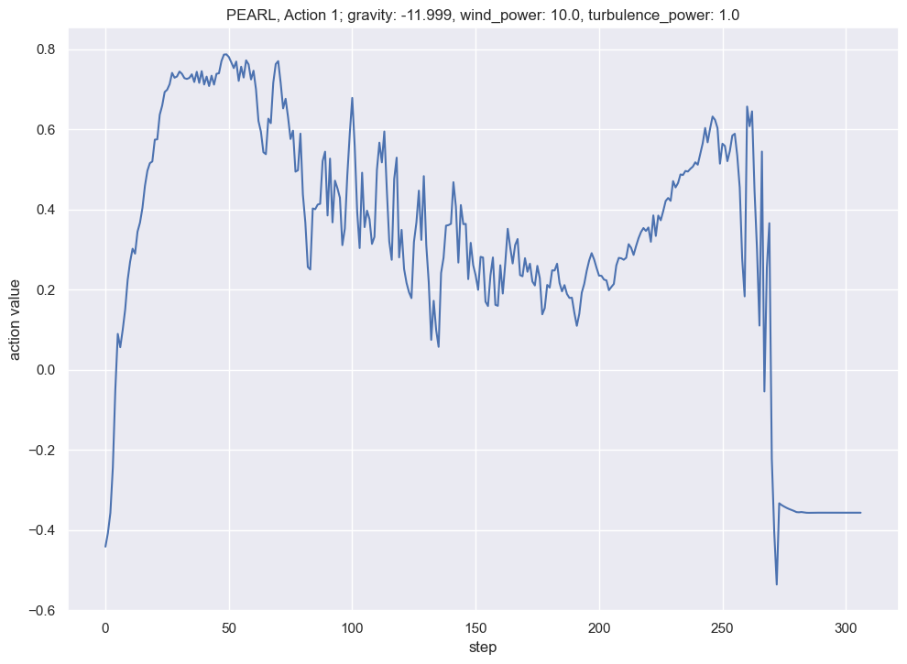
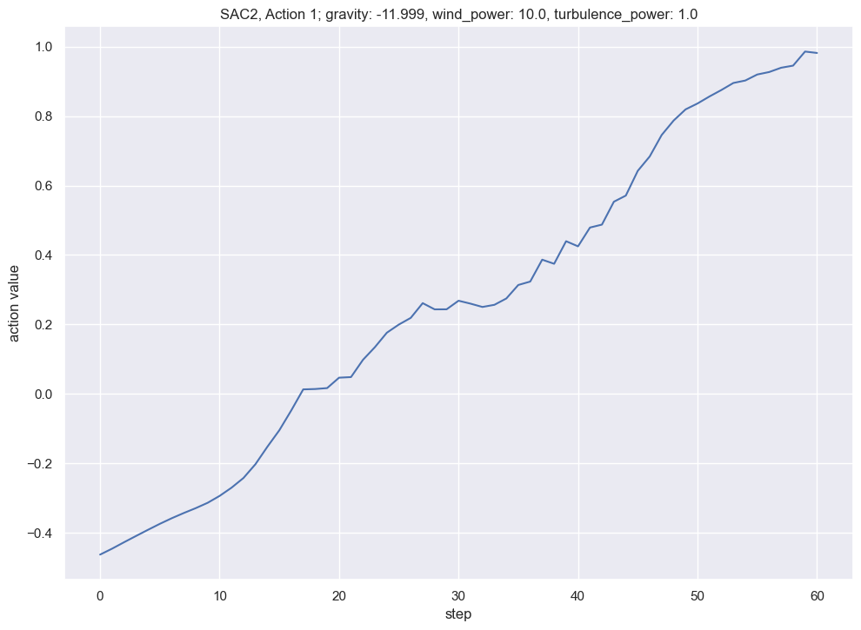
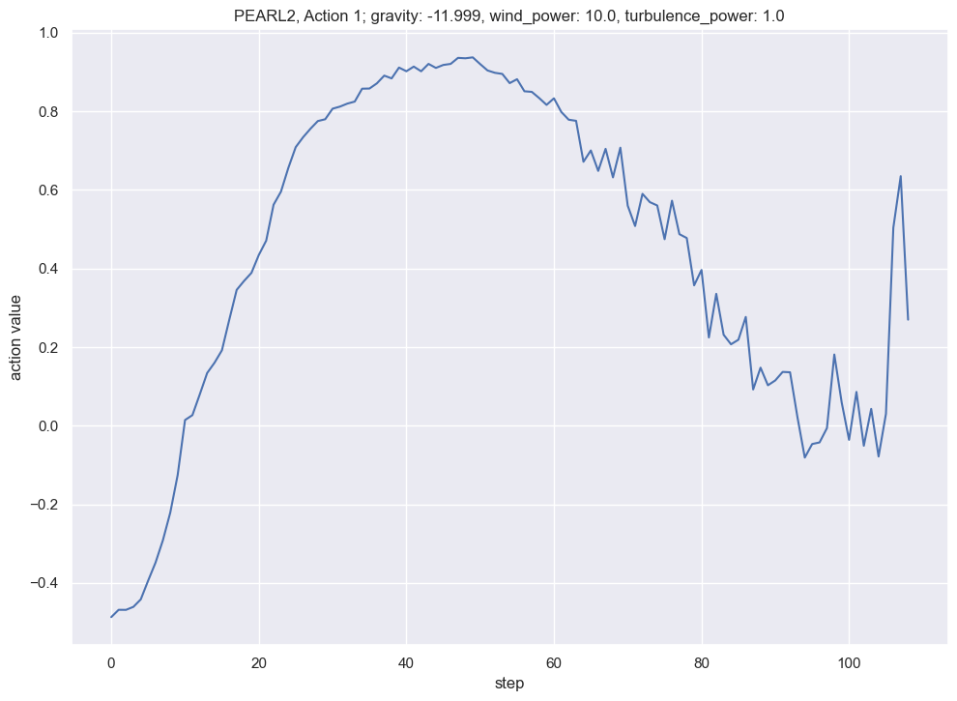
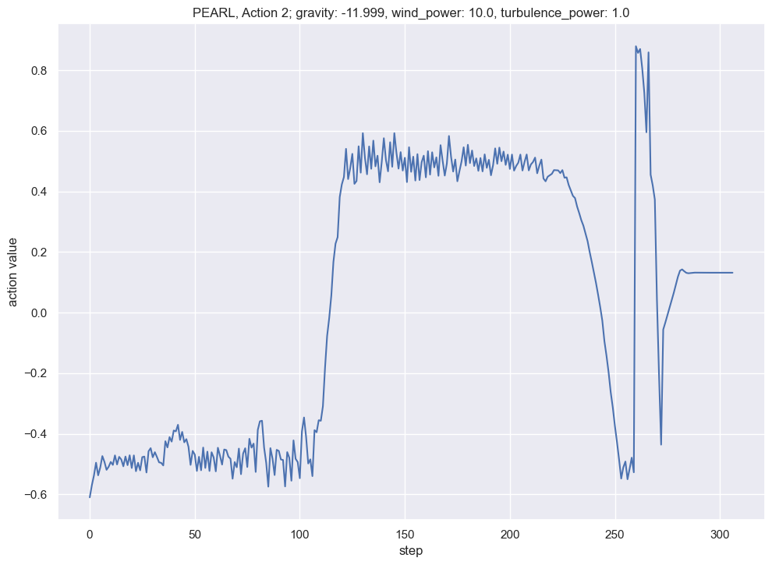
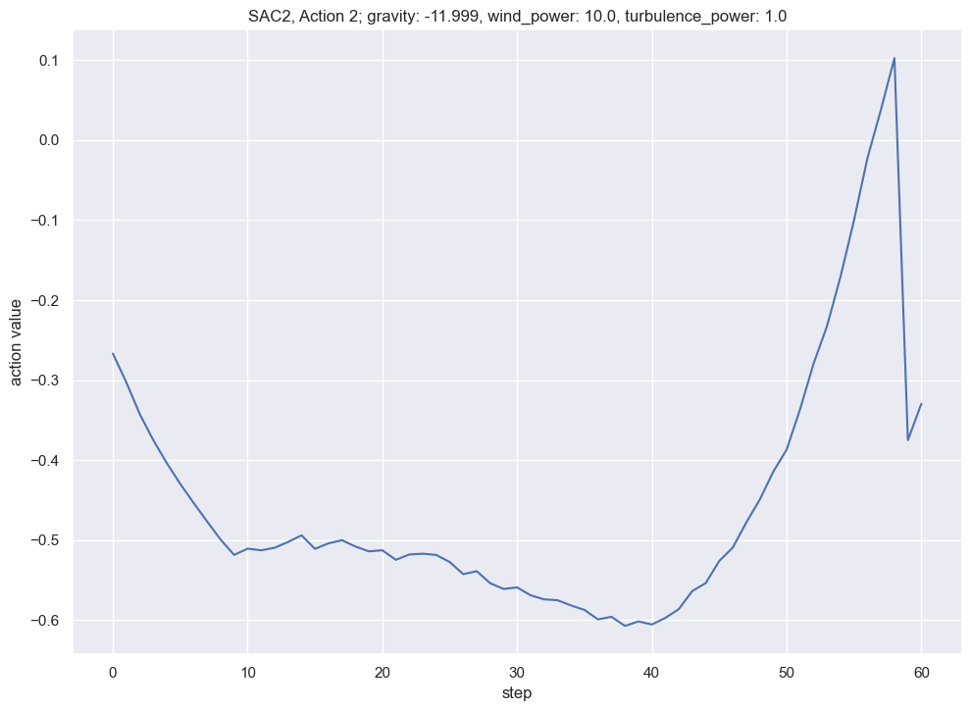
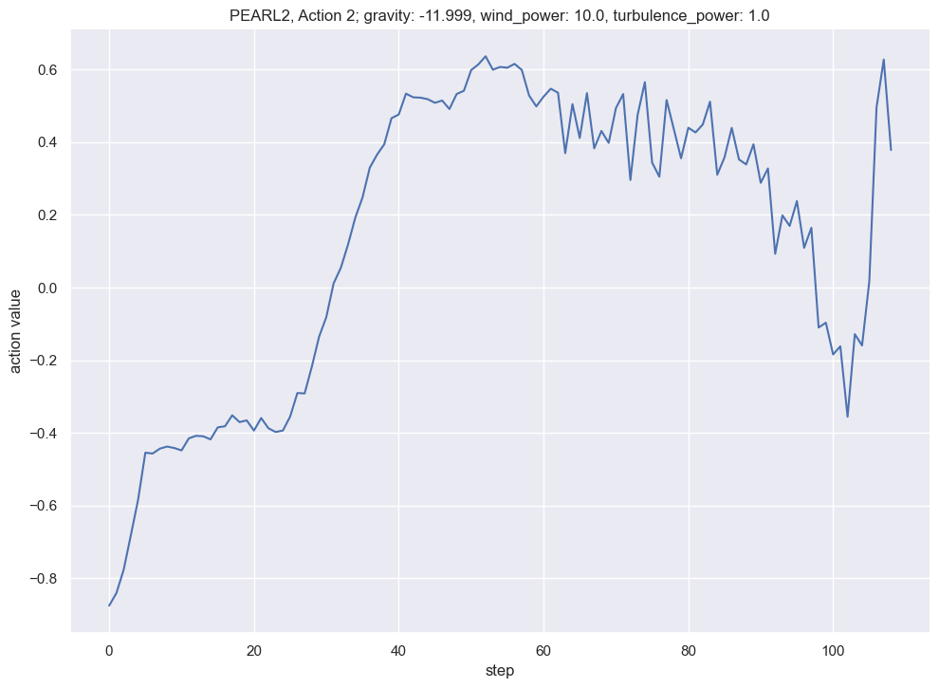
Action comparisons
PEARL
SAC2
PEARL2
main
side

Slide 18
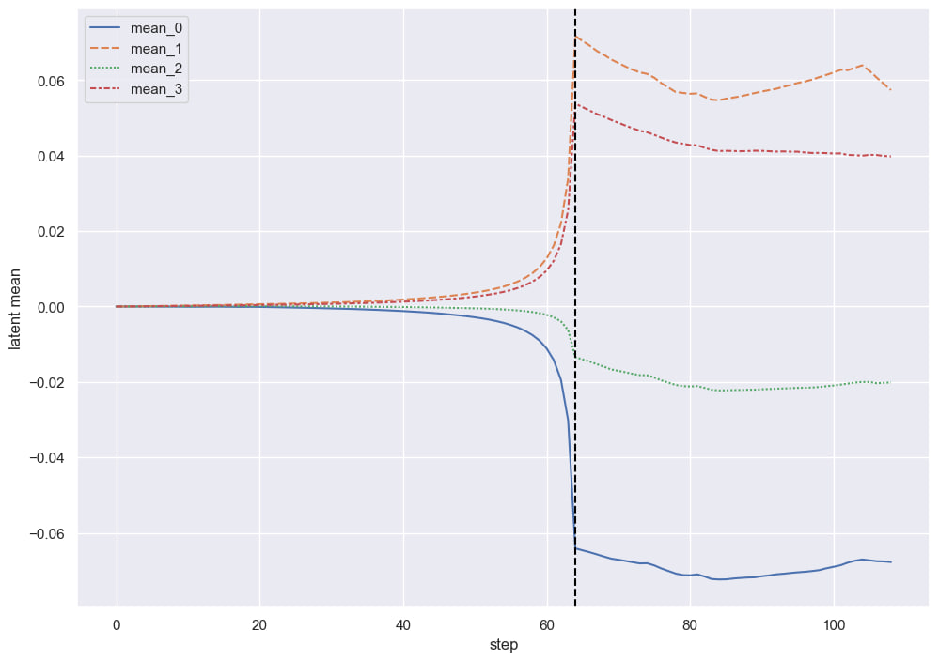
Dynamics of latent variables in PEARL2
main
side
After latent variables become "saturated“, actions begin to become more "flicking“, implicitly indicating uncertainty about the environment.

Slide 19
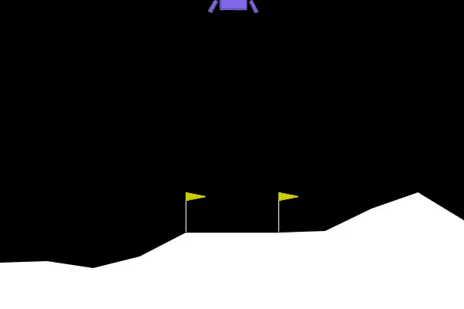


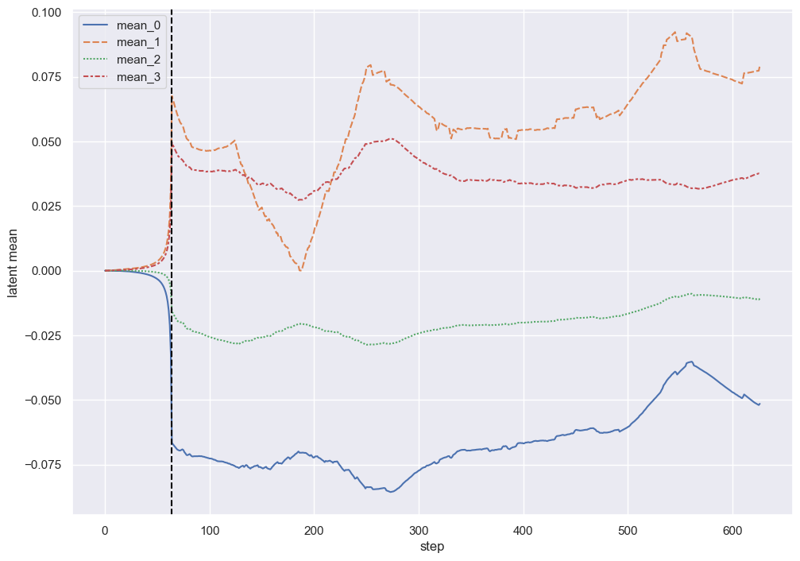
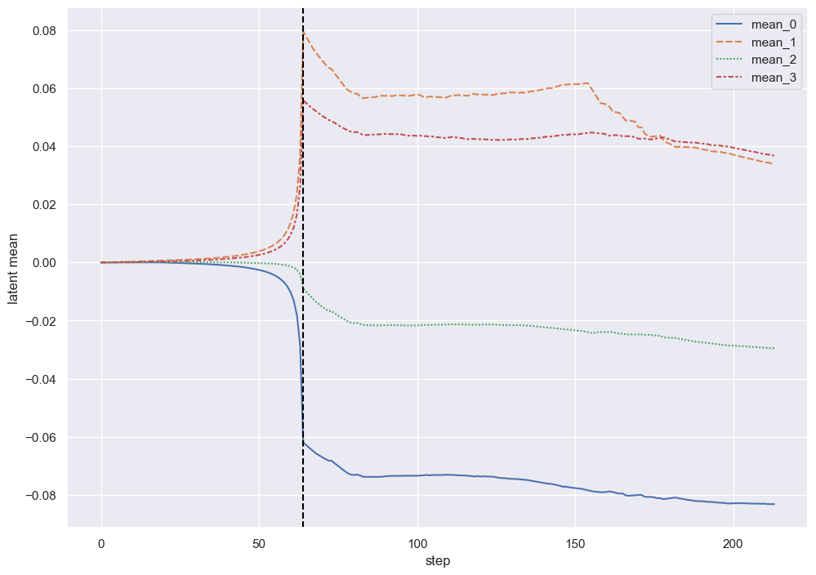
PEARL 2 with different wind trajectories
(but same environmental parameters)

Slide 20
Engineering results to show off:
The training process (>= 500 epochs) was completed at least 551 times
=~ 300 hours of compute time (4 cores, 16 gb RAM)
~3000 lines of code, debugged with pain and tears, including config files with total 200 options

Slide 21
Possible continuations
Smarter way to encode latent dimensions, possibly enforcing orthogonality between hidden features (as in modern GANs)
Incorporate uncertainty into latent variables in more formal way
Combined with our online latent variable generation approach, can be used to make models more safe
For example, high wind -> uncertainty about dynamics -> switch from learned approach to backoff classical control

